Slide 1

City Of St. George
Greater Baton Rouge Realtors Association
May 14, 2026

Slide 2
8:30 - 8:40 - Scot opening remarks, introduction of team, mayor remarks (if present), overview of meeting
8:40 - 8:45 - Stephanie & Justin discuss drainage, FEMA, stormwater
8:45 - 8:55 - Bryant summary of comprehensive plan
Nick Vasquez discuss permitting & inspections
8:55 - 9:00 - Mario discuss code enforcement - goal is compliance, not fines and improve quality of life for all
9:00 - 9:30 - Questions and Answers, open discussion

Slide 3
Dustin Yates
Mayor
Scot Byrd
Program Director
Stephanie Phillips
Engineering Director
Justin Dupuy
Engineering Program Manager
Bryant Dixon
Planning Director
Nicholas Vasquez
Building Official
Mario Lewis
Code Enforcement Manager

Slide 4
Form of Government
Mayor:
Dustin Yates
Police Chief:
Todd Morris
Interim Councilmen:
District 1: Richie Edmonds
District 2: Steve Monachello
District 3: Max Himmel
District 4: Patty Cook
District 5: Drew Murrell
At-Large: David Delluchi, Jim Talbot

Slide 5
The Lawrason Act
Mayor-Councilmen System
Mayor: Chief executive, oversees daily operations.
Councilmen: Legislative body, passes ordinances, manages policies.
Mayor votes only in a tie.
Powers & Responsibilities
Mayor: Enforces ordinances, supervises employees.
Aldermen: Set policies, approve budgets.
Elections & Terms
Mayor & aldermen elected by voters, serve 4-year terms.
Municipal Departments & Officials
Mayor appoints officials (with board approval).
Police, fire, and public works under municipal supervision.
Financial Management
Aldermen adopt budget; mayor ensures compliance.
Legislative Authority
Aldermen pass & regulate ordinances on safety, zoning, and operations.

Slide 6
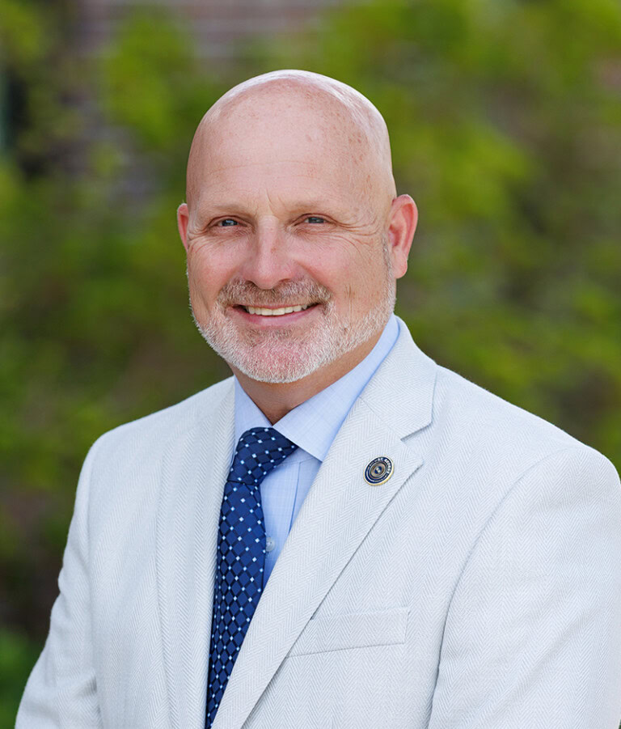
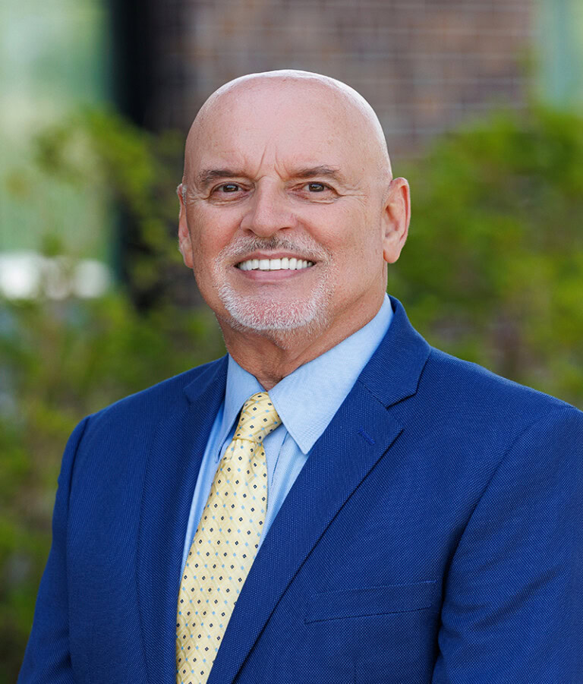
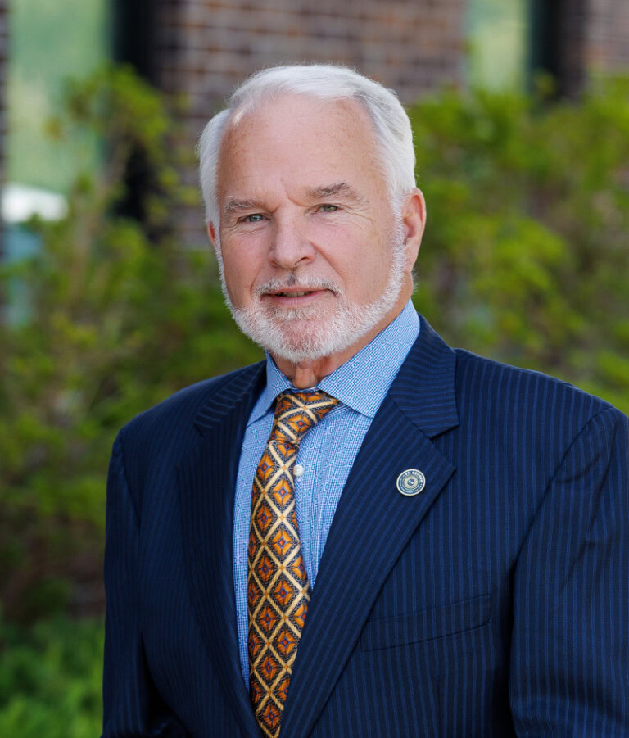
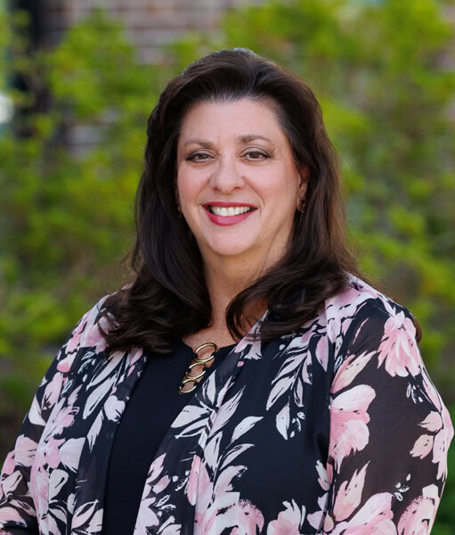
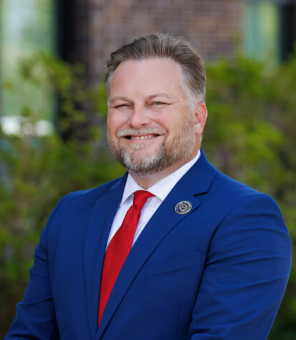
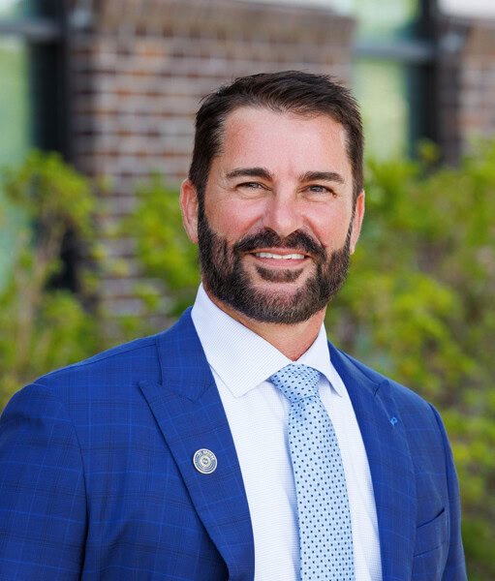
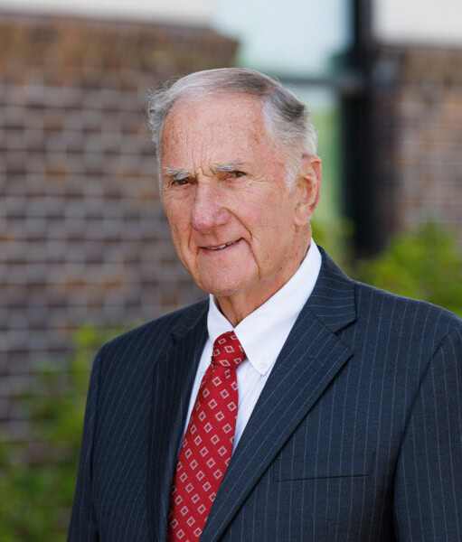
City Council & Districts
Richie Edmonds
District 1
Steve Monachello
District 2
Max Himmel
District 3
Patty Cook
District 4
Drew Murrell
District 5
David Delluchi
At Large
Jim Talbot
At Large

Slide 7
Website Resources
City of St. George Website
(Official Website) www.stgeorgela.gov
Services https://stgeorgela.gov/services/#gsc.tab=0
Planning & Zoning Section https://stgeorgela.gov/services/planning-zoning/#gsc.tab=0
Planning & Zoning Application Fee Schedule https://stgeorgela.gov/media/qlac0utc/application-fee-schedule.pdf
City Council https://stgeorgela.gov/about-st-george/city-council/#gsc.tab=0

Slide 8
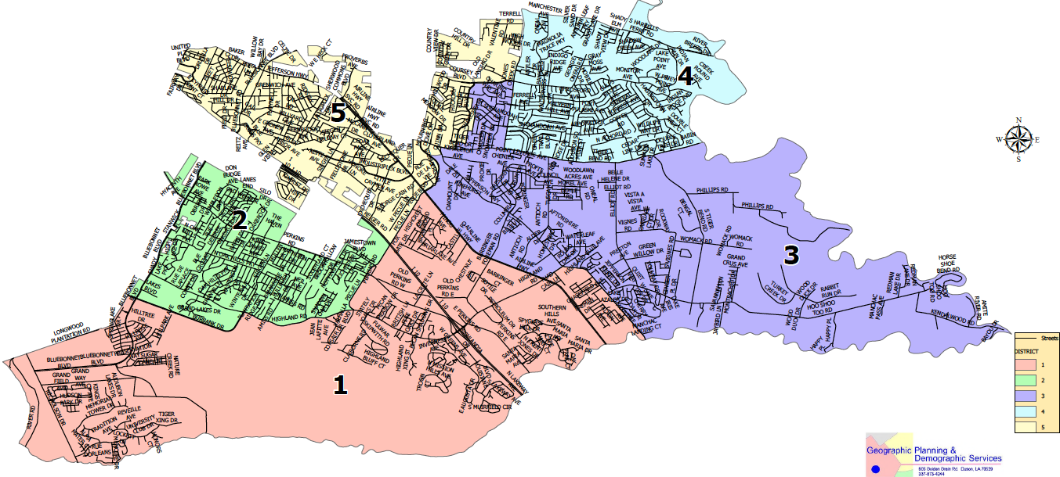
City Council District Map

Slide 9
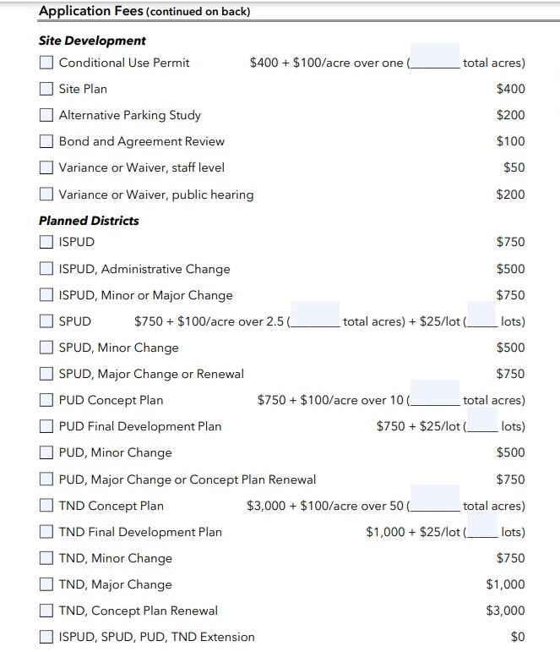
Fees & Processes

Slide 10
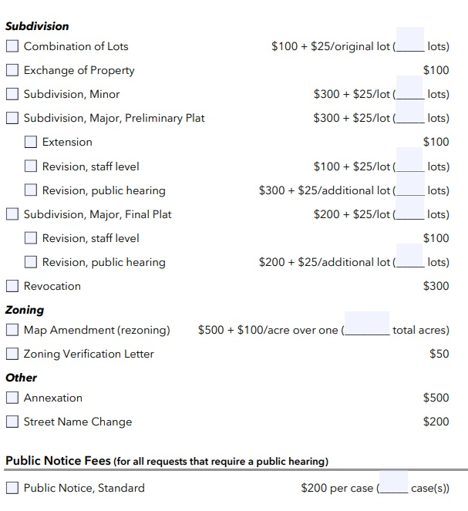
Fees & Processes

Slide 11
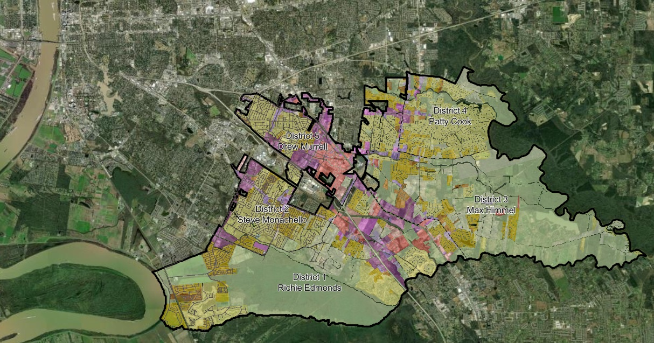
Drainage, Stormwater, FEMA, and Infrastructure
Engineering Project Manager:
Justin Dupuy
Engineering Director:
Stephanie Phillips

Slide 12
Planning & Development
Planning & Zoning Director:
Bryant Dixon
City Building Official:
Nick Vasquez

Slide 13
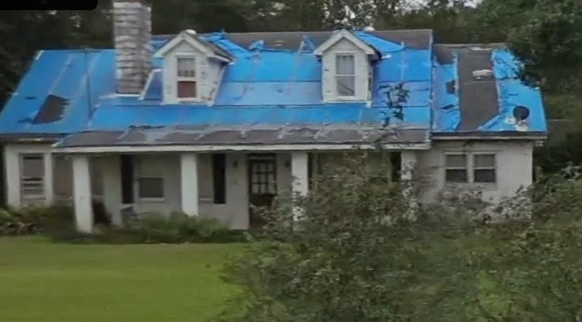
Code Enforcement
Code Enforcement Manager:
Mario Lewis
Blighted properties, high grass, junk cars, debris, trash & junk, drainage
violations, stormwater contamination, zoning violations, work without permits.
other code violations…

Slide 14
Thank you for your time and participation.
Questions and
Answers

